Slide 1
Chapter 1

Slide 2
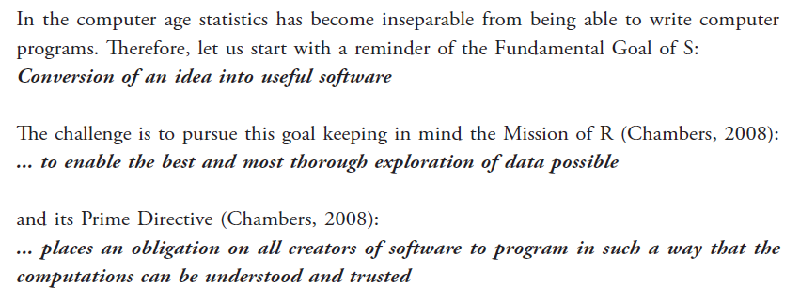

Slide 3
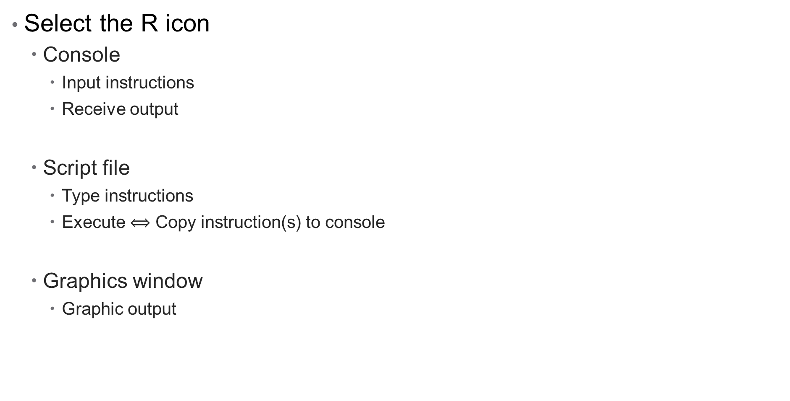
R system
Select the R icon
Console
Input instructions
Receive output
Script file
Type instructions
Execute $⟺$ Copy instruction(s) to console
Graphics window
Graphic output

Slide 4
R Studio
Open-source integrated development environment for R

Slide 5
R objects
‘Everything’ in R is an object
Scalar value
Vector
Matrix
Function
…
Objects are stored by default in the Global environment
objects()
ls()
Remove objects with
rm(name1, name2, …)
rm (list = objects())

Slide 6
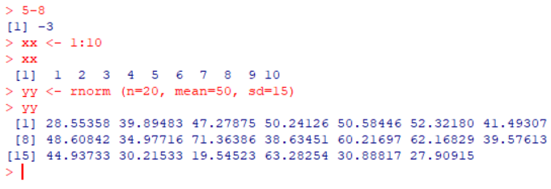
Interpretive language
Interpreter
Evaluate instruction immediately and provide answer
Don’t have to wait for all instructions to execute before output is obtained.
Compiler
Compile complete program
Execute as a unit
Calc.program
{
5-8
xx <- 1:10
yy <- rnorm(n=20, mean=50, sd=15)
return (xx, yy)
}
Compile Calc.program to Machine language => CP.exe
Run CP.exe
xx: 1 2 3 4 5 6 7 8 9 10
yy: 28.55358 39.89483 47.27875 50.24126 50.58446 52.32180 41.49307
48.60842 34.97716 71.36386 38.63451 60.21697 62.16829 39.57613
44.93733 30.21533 19.54523 63.28254 30.88817 27.90915
Faster execution
Better memory use

Slide 7
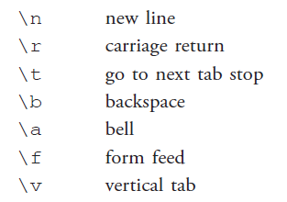
Escape sequences
Special meaning for R evaluator
\ in R interpreted as part of special instruction
Folders in Windows
C:\Users\slubbe\OneDrive - Stellenbosch University\My Documents\Teaching
Folders in R
C:\\Users\\slubbe\\OneDrive - Stellenbosch University\\My Documents\\Teaching
or
C:/Users/slubbe/OneDrive - Stellenbosch University/My Documents/Teaching

Slide 8
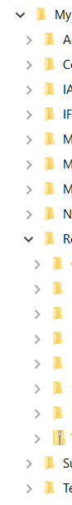
R projects
F:
In R Studio
File > New Project
Open R project
Always use relative folder paths
read.csv ("csv data\\filename.csv")
write (output.mat "output.txt")
getwd() provides the current folder
Project1
setwd() can be used to change the current folder
Project1
csv data

Slide 9
R projects
F:
H:
In R Studio
File > New Project
Open R project
Always use relative folder paths
read.csv ("csv data\\filename.csv")
F:\Project1\csv data\filename.csv
H:\Projek\csv data\filename.csv
read.csv (“f:\\Project1\\csv data\\filename.csv")
F:\Project1\csv data\filename.csv
File does not exit
write (output.mat "output.txt")
F:\Project1\output.txt
H:\Projek\output.txt
Project1
Projek
csv data
csv data

Slide 10
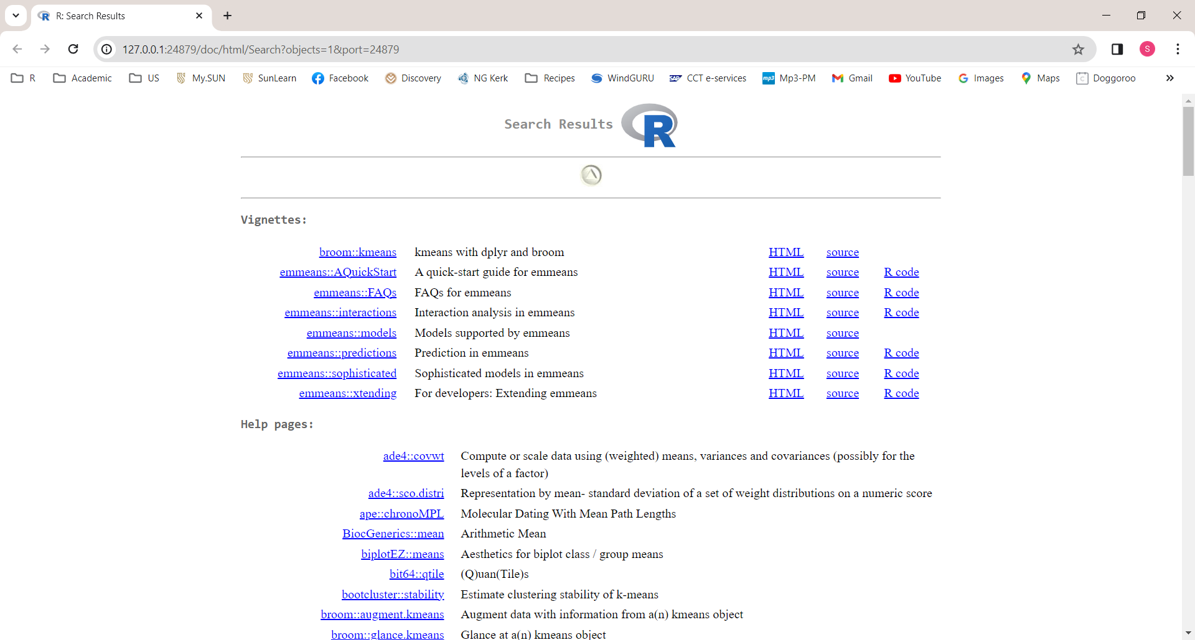
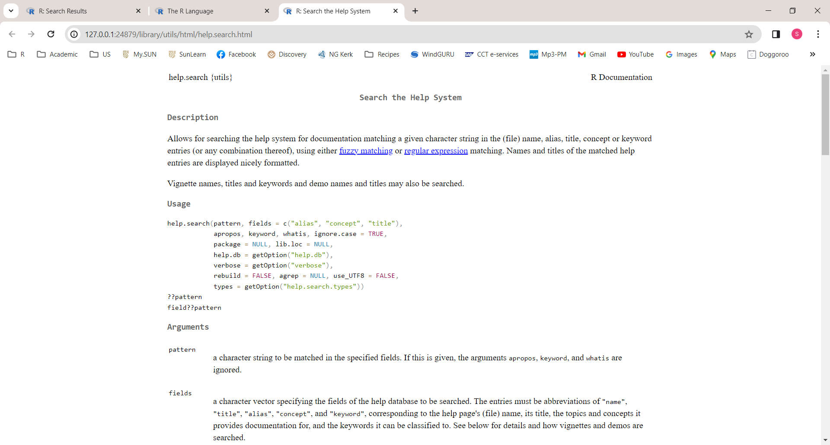
HELP
?mean
??mean
help.start()
Top level of help file contents
help.search()

Slide 11
Assignment
Creating objects: name <- object, e.g. xx <- 1:10
object <- name, e.g. 1:10 -> xx
Object names are case sensitive
X and x are two different objects
If the object name is already in use, the contents will be replaced without any warning
Function objects
mean
Contents of the function mean
mean ()
Execute the function mean

Slide 12
Assignment
# for comments
Assignment xx <- 1:10
Assignment 1:10 -> xx
Arguments mean (x = 1:10)
Equality x == 5
TRUE / FALSE

Slide 13
Packages
search()
Once off: Install package
install.packages("biplotEZ")
Every R session: Load package for use
library (biplotEZ)
or
require (biplotEZ)

Slide 14
Finding objects
objects()
objects(pos = 2)
objects (pattern = "dat")
Read through section 1.7 regarding regular expressions

Slide 15
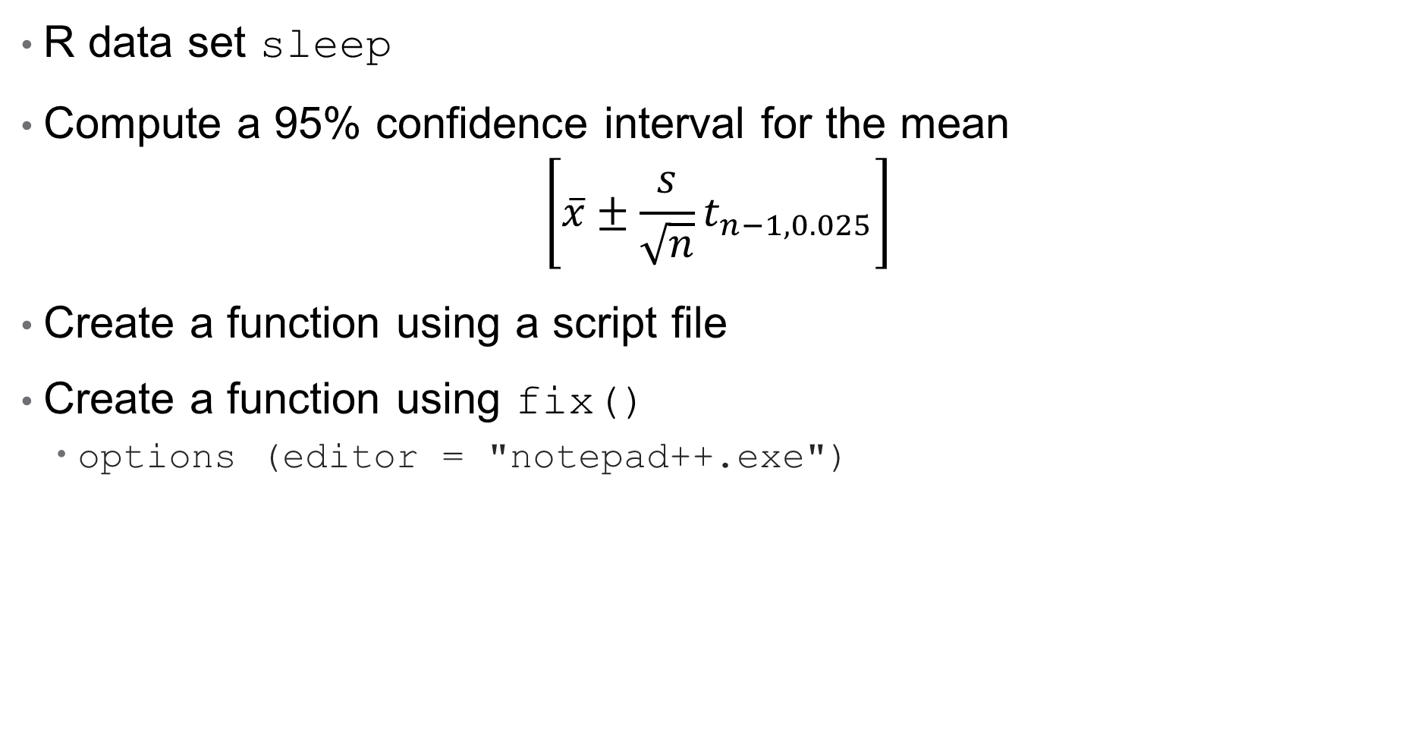
Simple functions
R data set sleep
Compute a 95% confidence interval for the mean
$$\left[\overline{x}±\frac{s}{\sqrt{n}}t_{n−1,0.025}\right]$$
Create a function using a script file
Create a function using fix()
options (editor = "notepad++.exe")

Slide 16
Functions
Function structure
func.name <- function (list of arguments)
{ R code }
When the function func.name() is called, the code in { } is executed.
Chapter 7

Slide 17
Default function arguments
plot.factor
function (x, y, legend.text = NULL, ...)
{
}
x and y do not have any default values
The default for legend.text is NULL
Chapter 7

Slide 18
pmatch()
Partial matching
pmatch("med", c("mean", "median", "mode")) # returns 2
pmatch("m", c("mean", "median", "mode")) # returns NA
pmatch("", "") # returns NA
seq(from = 1, to = 1, by = ((to - from)/(length.out - 1)), length.out = NULL, along.with = NULL, ...)
seq(from = 1, to = 100, length.out=10)
[1] 1 12 23 34 45 56 67 78 89 100
seq(f=1, t=100, len=10) # partial matching
[1] 1 12 23 34 45 56 67 78 89 100
loess(formula, data, degree = 2, drop.square = FALSE)
loess(Petal.Width ~ Sepal.Length, data=iris, degree = 2, drop.square = FALSE)
loess(Petal.Width ~ Sepal.Length, data=iris, degree = 2)
loess(Petal.Width ~ Sepal.Length, data=iris, d = 2) # d not unique
argument 3 matches multiple formal arguments
Chapter 7

Slide 19
Returning output
my.func <- function(a=5) a+2
my.func()
[1] 7
my.func <- function(a=5) { a+2 }
my.func()
[1] 7
my.func <- function(a=5)
{ a+2
}
my.func()
[1] 7
Chapter 7

Slide 20
Returning output
my.func <- function(a=5)
{ number <- (a+3)^2
number/a
}
my.func <- function(a=5)
{ number <- (a+3)^2
return(number/a)
}
my.func <- function(a=5)
{ number <- (a+3)^2
list(number/a)
}
Chapter 7

Slide 21
Returning output
my.func <- function(a=5)
{ number <- (a+3)^2
list (number, number/a) }
my.func()
[[1]]
[1] 64
[[2]]
[1] 12.8
my.func <- function(a=5)
{ number <- (a+3)^2
list (numerator=number, ratio=number/a) }
> my.func ()
$numerator
[1] 64
$ratio
[1] 12.8
Chapter 7

Slide 22
Returning output
my.func <- function(a=5)
{ number <- (a+3)^2
if (number < 10) return(number)
list (numerator=number, ratio=number/a)
}
my.func ()
$numerator
[1] 64
$ratio
[1] 12.8
my.func (a=0.1)
[1] 9.61
Chapter 7

Slide 23
invisible()
boxplot.default <- function (x, ..., plot = TRUE, other arguments
{ # some computations
z <- list(stats = stats, n = ng, conf = conf, out = out, group = group, names = names)
if (plot) {
# do some plotting
invisible(z)
}
else z
}
Chapter 7

Slide 24
New line
> a <- 5 + 7
> a
[1] 12
> a <- 5 +
+ 7
> a
[1] 12
> a <- 5
> + 7
[1] 7
> a
[1] 5
Chapter 7

Slide 25
Computations by a computer
Assignment: x <- x + k
Using “=“ for assignment: x = x + k
Overflow and underflow
Real numbers (with infinite non-zero decimals) cannot be exactly represented
Limitations in the minimum and maximum that can be represented
.Machine
> .Machine
$double.eps
[1] 2.220446e-16
$double.neg.eps
[1] 1.110223e-16
$double.xmin
[1] 2.225074e-308

Slide 26

R Markdown
Read more …
https://www.markdownguide.org/
https://zsmith27.github.io/rmarkdown_crash-course/
https://r4ds.had.co.nz/r-markdown.html

Slide 27
R Markdown
Markdown
Markup language with plain-text formatting syntax.
R Markdown
Markdown with R code chunks
knitr
R package to execute the code and converts .Rmd to .md
Pandoc
Document converter that renders the .md file to output
Output
PDF, HTML, MS Word, and others

Slide 28
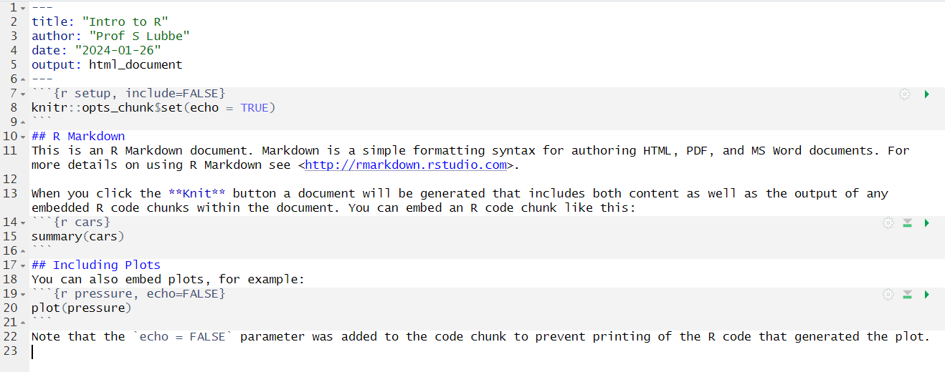
RStudio template

Slide 29
YAML

Slide 30
YAML
YAML is a human-readable data serialization language. It is commonly used for configuration files and in applications where data is being stored or transmitted.
Title
title: "My Title"
Subtitle
subtitle: "My Subtitle"
Author(s)
author: "Zachary M. Smith, John Doe"

Slide 31
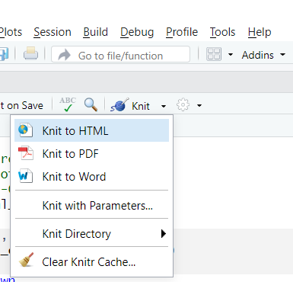
YAML
Date
static date: "March 3rd, 2020"
dynamic date: "r Sys.Date()"
Output
HTML: output: html_document
output: html_notebook
HTML notebook also contains the full source code
PDF: output: pdf_document
MS Word: output: word_document
Open Document Text odt_document
Rich Text Format rtf_document
Markdown document md_document
Github document github_document
Automatically updates the YAML before knitting

Slide 32
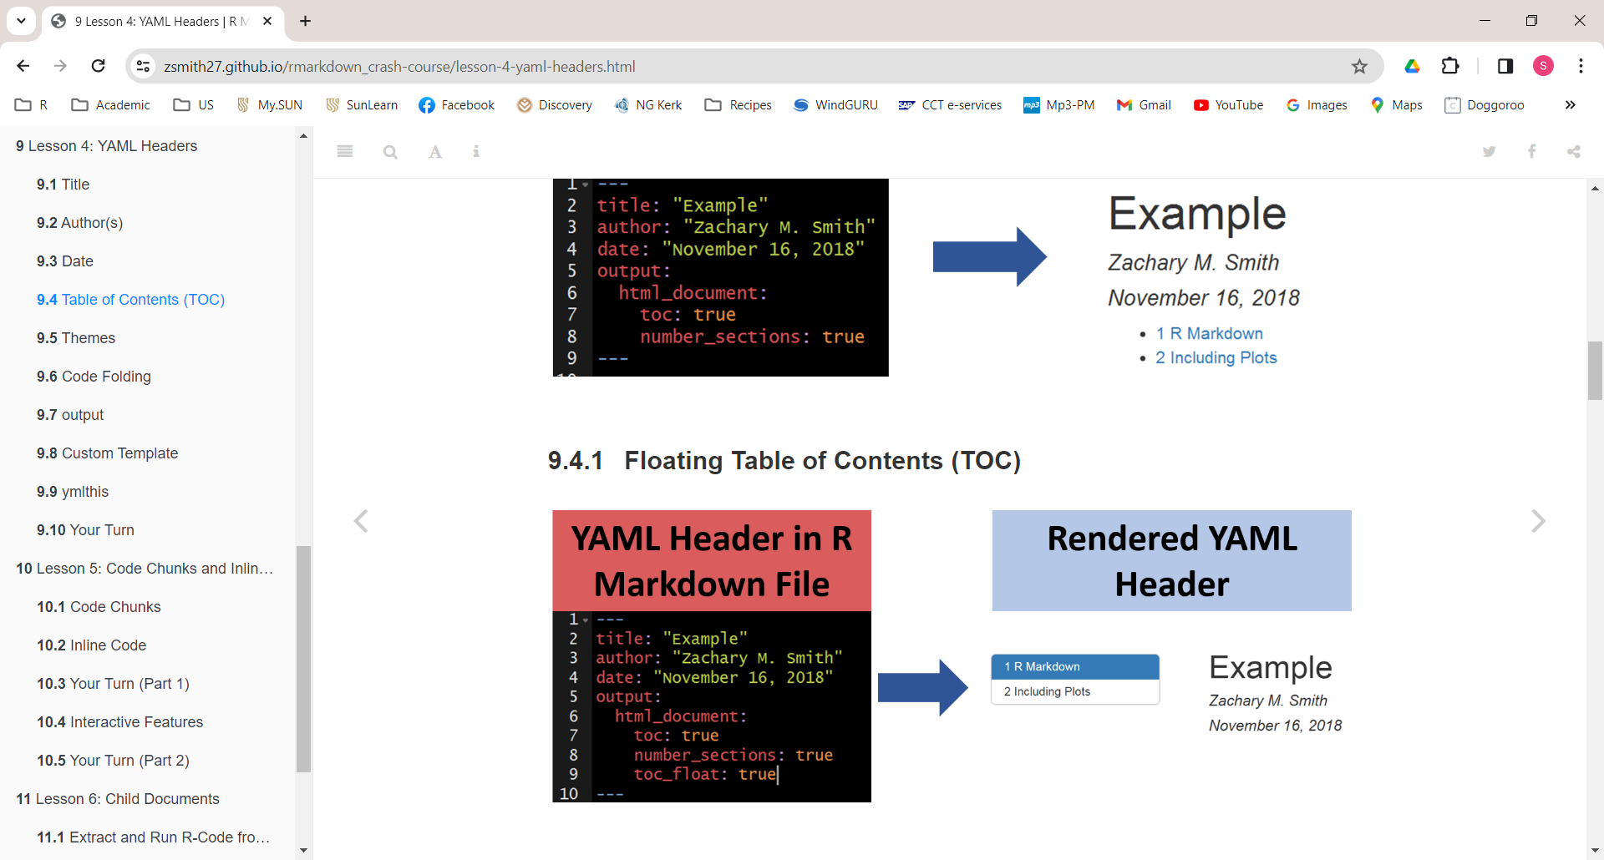
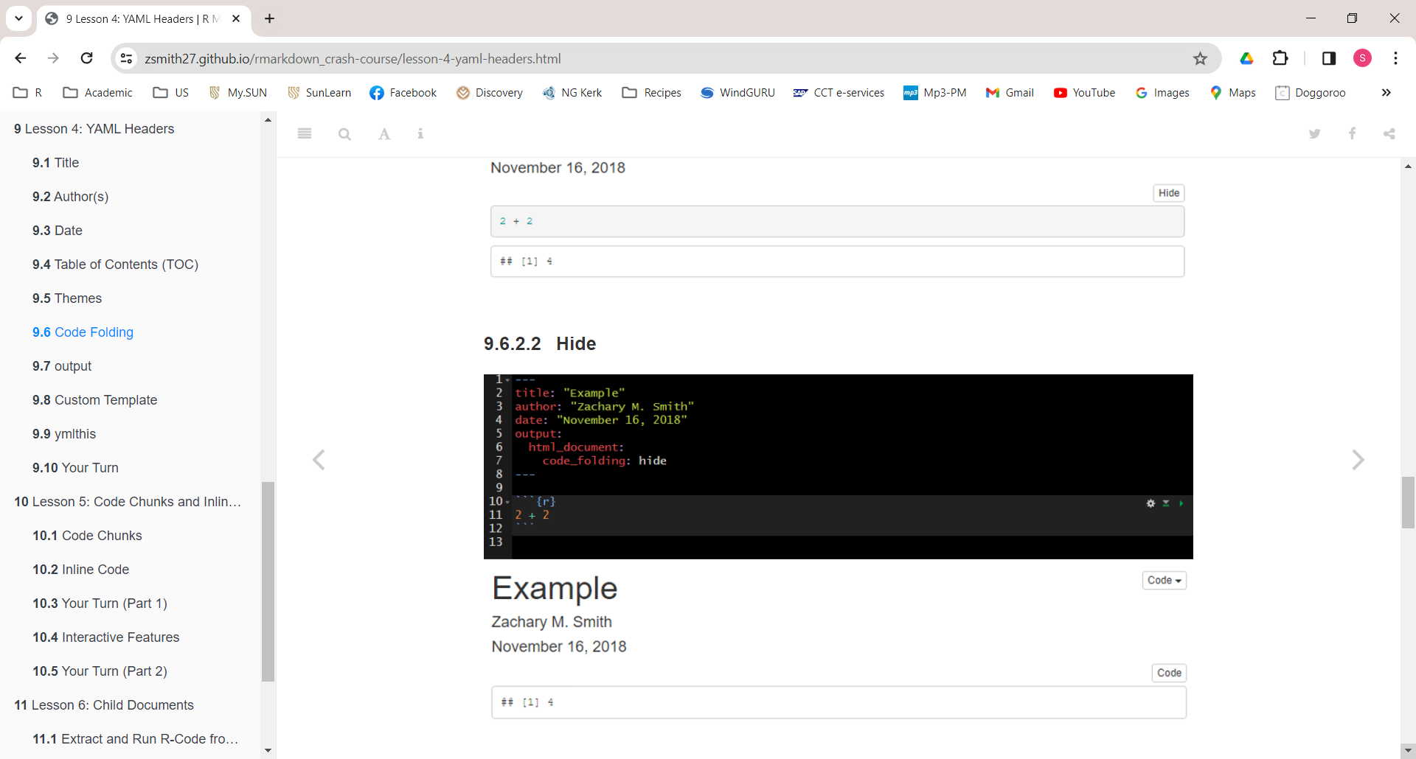
YAML
Table of contents
output: xxx_document: toc: true number_sections: true
Floating table of contents
output: xxx_document: toc: true number_sections: true toc_float: true
Themes
output: xxx_document: theme: cerulean
Example themes: https://www.datadreaming.org/post/r-markdown-theme-gallery/
Code folding
output: xxx_document: theme: cerulean
Code chunk is hidden with a button to click to show the underlying code chunk
Fixed on page
Floating

Slide 33
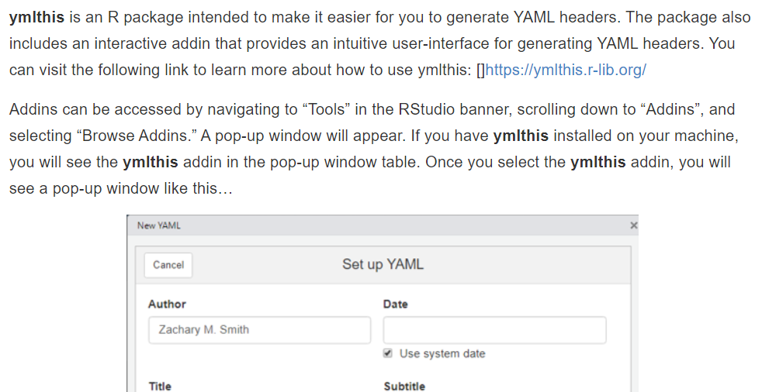
YAML
Custom template
output: word_document: reference_doc: filename.docx
ymlthis

Slide 34
Text

Slide 35
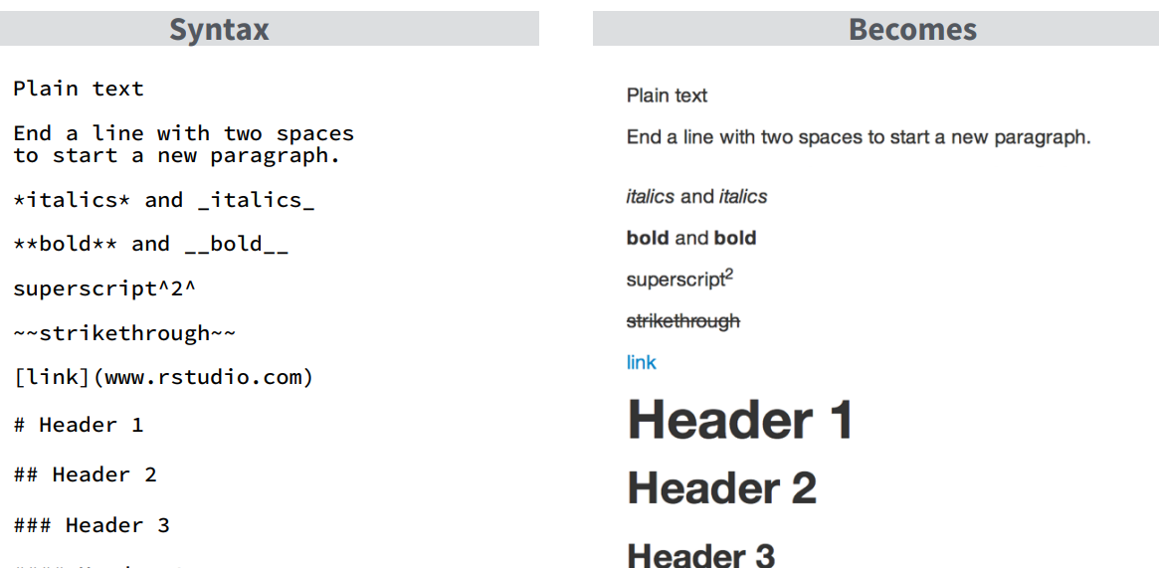
Text

Slide 36
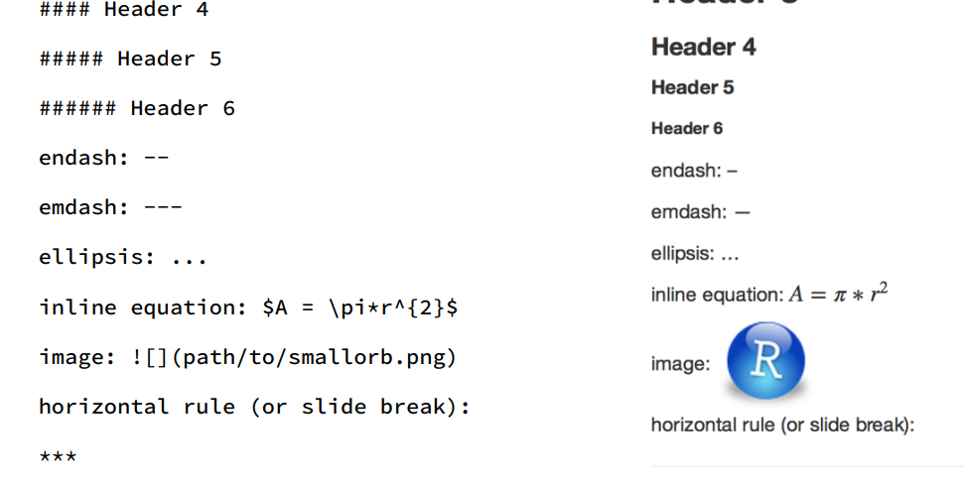
Text

Slide 37
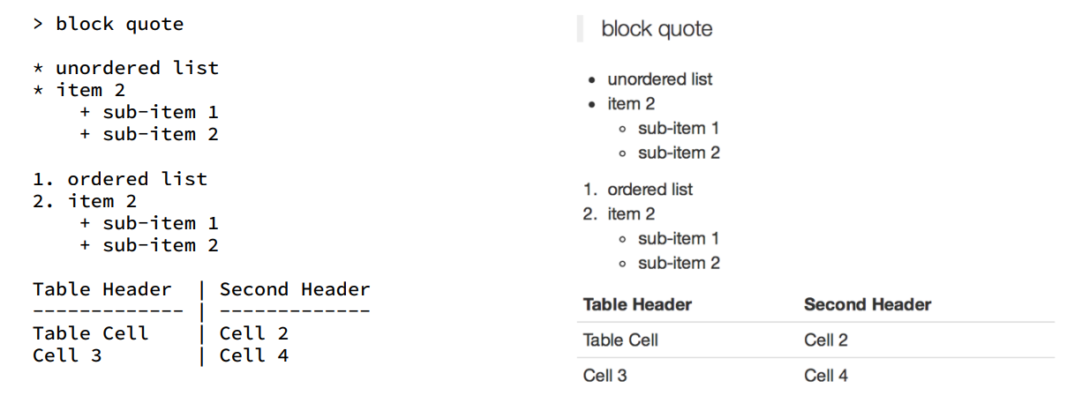
Text

Slide 38
Code chunks

Slide 39
Code chunks
```{r name}
R code
```
Include R code in output
```{r name, echo = TRUE}
R code
```
Do not include R code in output
```{r name, echo = FALSE}
R code
```

Slide 40
Code chunks
Figures
```{r name, fig.height = y, fig.width = x, fig.cap = "Some title"}
R code
```
Numbering figures
Install R package bookdown
output: bookdown::html_document2
```{r iris_petal, fig.height = 5, fig.width = 10, fig.cap = "Petal length and width of iris data"}
plot (iris[,3], iris[,4], col="red“)
```
In figure \@ref(fig:IrisScatter) above we see that ...

Slide 41
Code chunks
Messages, warnings and errors
Suppress messages
```{r name, message = FALSE}
R code
```
Suppress warnings
```{r name, warning = FALSE}
R code
```
Don’t execute code chunk (typically because there is an error)
```{r name, include = FALSE}
R code
```

Slide 42
More on RMarkdown
Include the code but don’t evaluate
```{r name, eval = FALSE}
R code
```
Include the code and evaluate but don’t show results
```{r name, results = 'hide'}
R code
```
Include the code and evaluate but don’t show plots
```{r name, fig.show = 'hide'}
R code
```

Slide 43
More on RMarkdown
Global options: only set once for whole document
knitr::opts_chunk$set(fig.width = 8, fig.height = 4)
Inline code
The mean value of column 1 is `r mean(mat[,1])`.
Continue rendering, even if there is an error in the code
```{r name, error = TRUE}
R code
```
R Markdown prints data frames and matrices as you’d see them in the console
```{r name, error = TRUE}
knitr::kable( mtcars[1:5, ], caption = "A knitr kable." )
```

Slide 44
Git and GitHub
Read more …
https://happygitwithr.com/

Slide 45
Git and GitHub
What is Git?
Git is a version control system.
Its original purpose was to help groups of developers work collaboratively on big software projects. Git manages the evolution of a set of files – called a repository – in a sane, highly structured way.
What is GitHub?
Cloud based home for your Git-based projects.

Slide 46

Install Git to local PC
https://git-scm.com/download/win

Slide 47
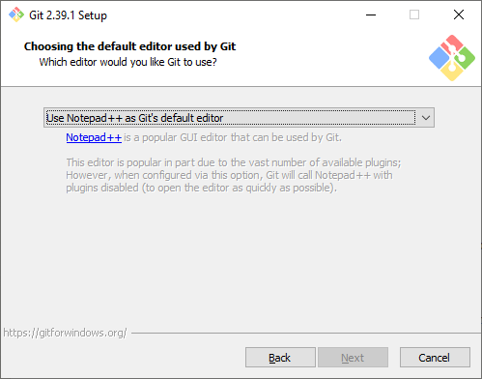
Install Git to local PC
Use defaults for all fields except Editor

Slide 48

Create GitHub account
https://github.com/

Slide 49
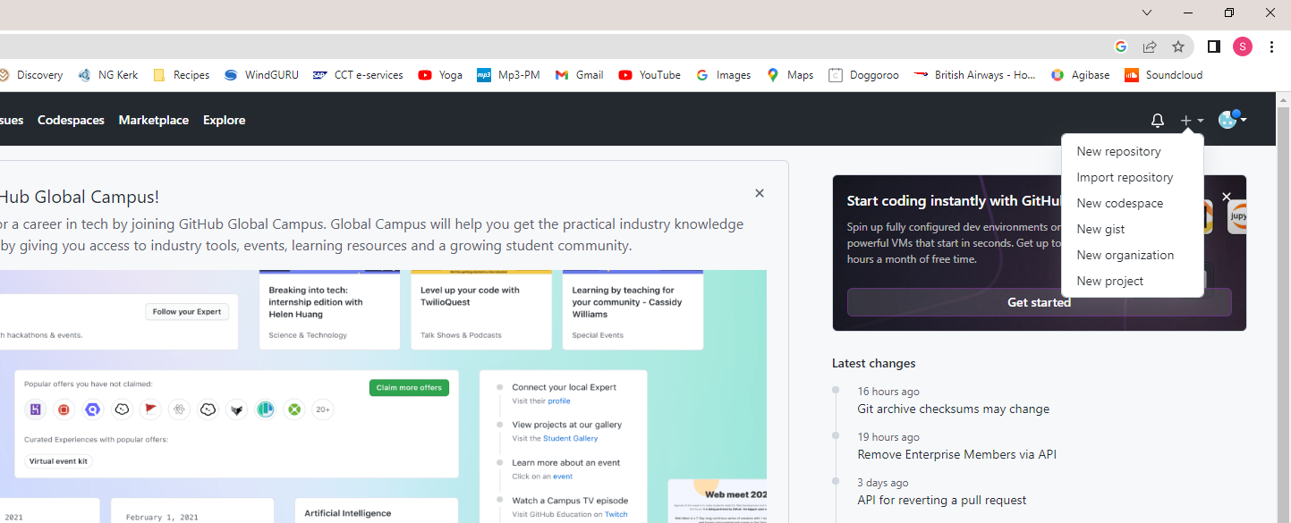

Create cloud repository

Slide 50
Visual Studio Code
Visual Studio Code, also commonly referred to as VS Code, is a source-code editor developed by Microsoft for Windows, Linux and macOS.
Visual Studio Code combines the simplicity of a source code editor with powerful developer tooling
Install Visual Studio Code
https://code.visualstudio.com/download
Keep all default installation settings
Done in FHARGA

Slide 51
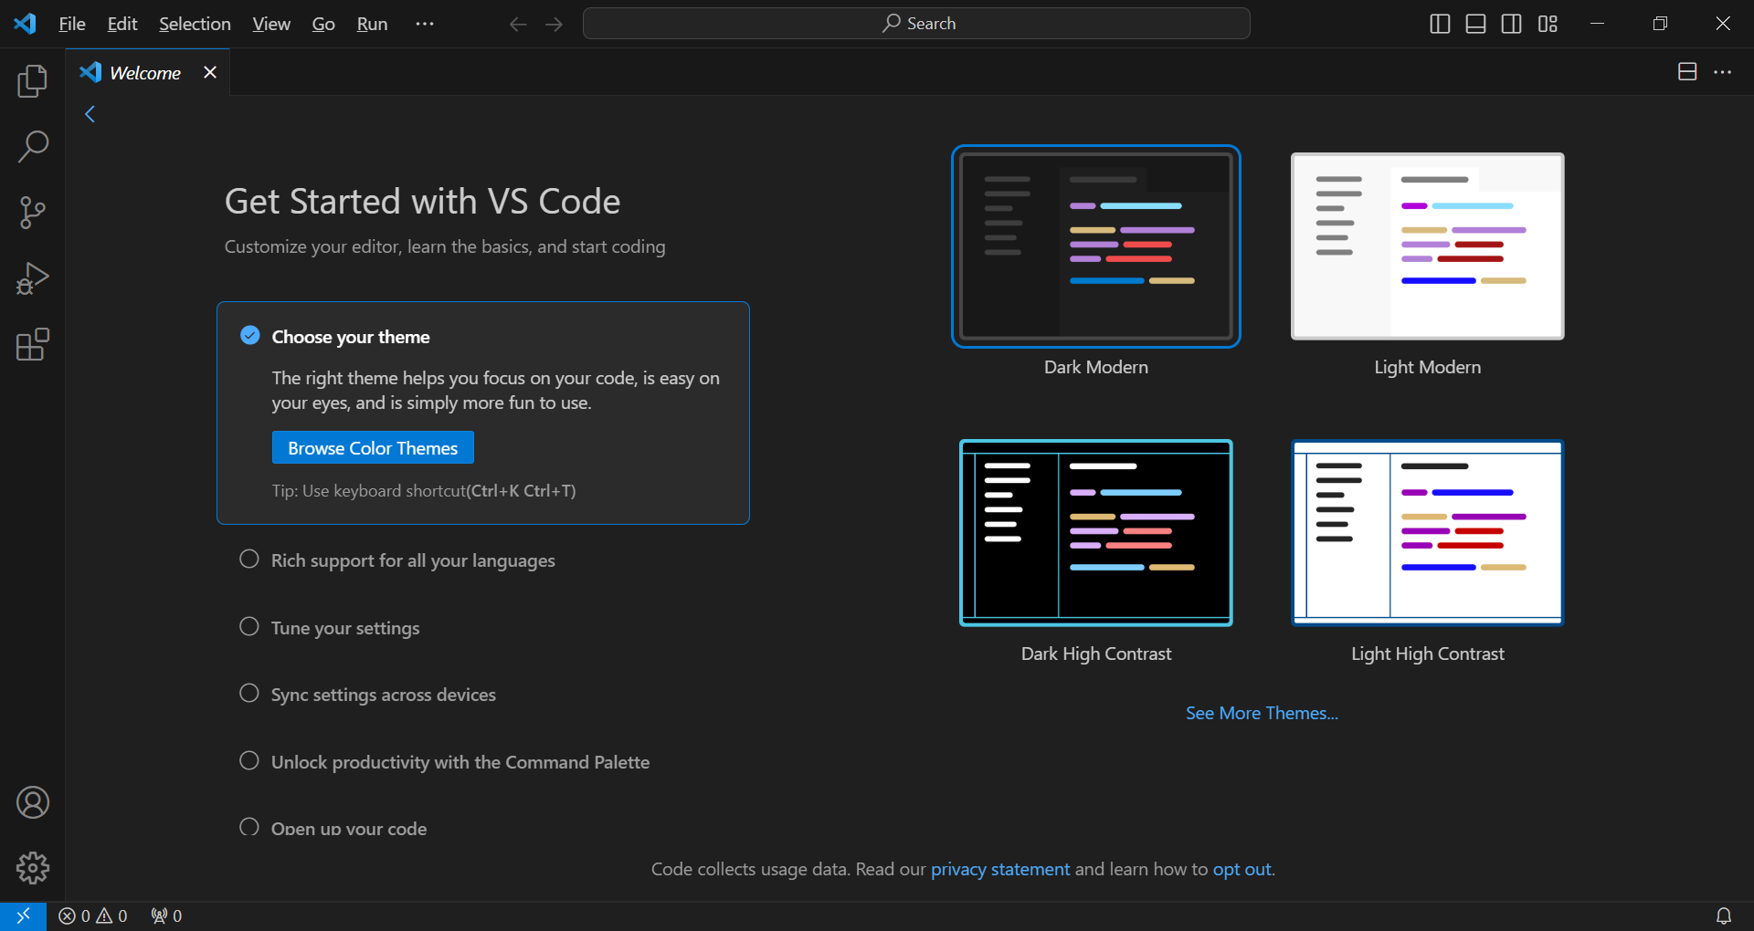
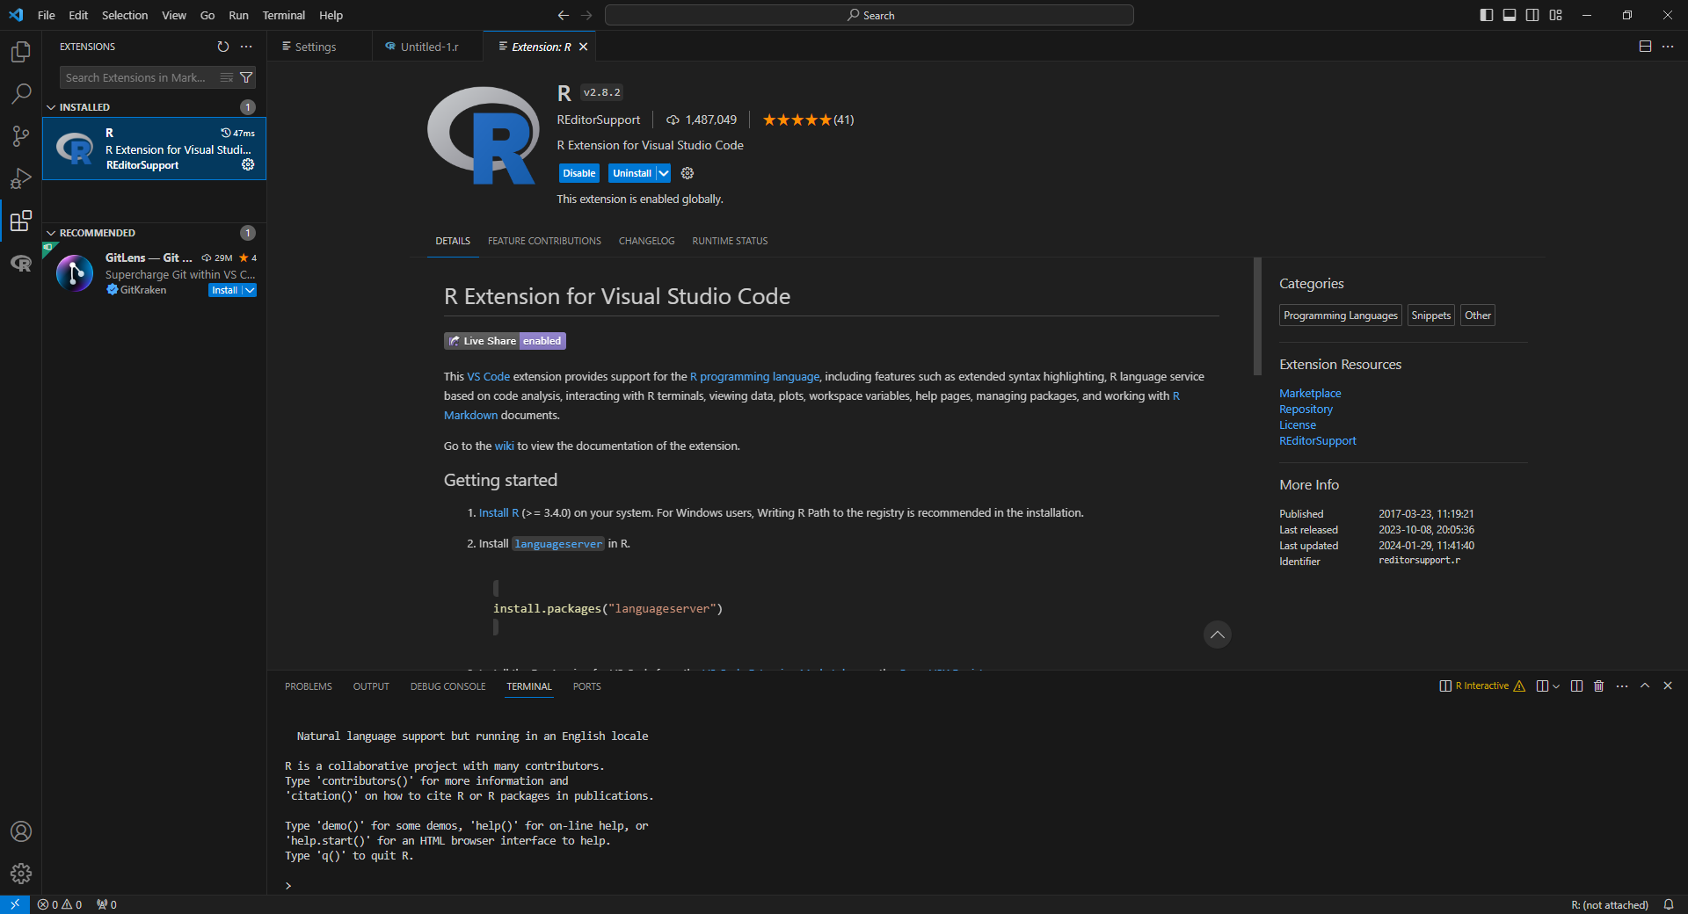
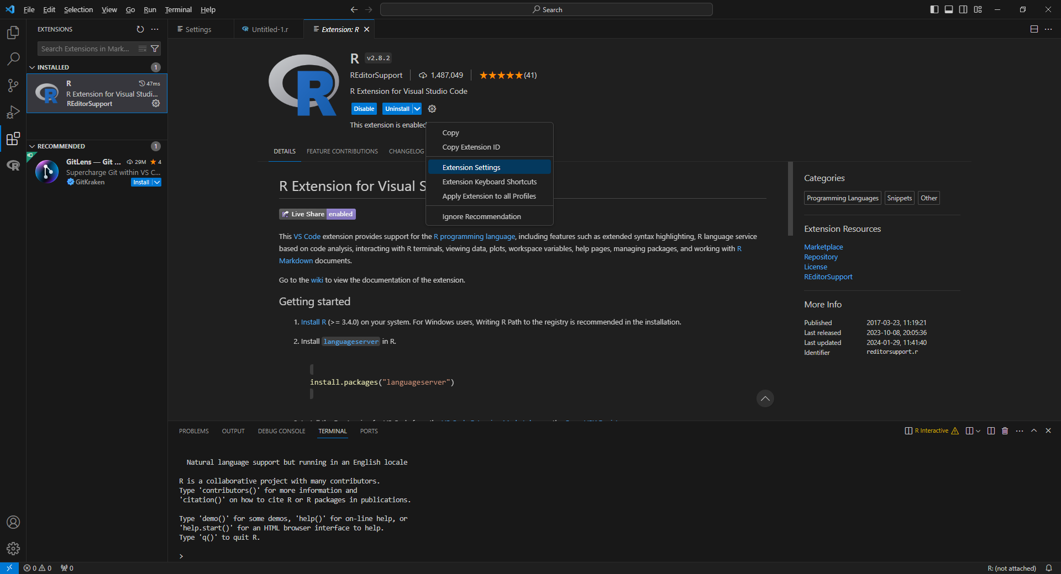
Once off / FHARGA every time you log in
Open VSC
Extensions
Search R
Install R extensions for visual studio code
In R
install.packages("languageserver")
Settings
Extension settings
Done in FHARGA

Slide 52
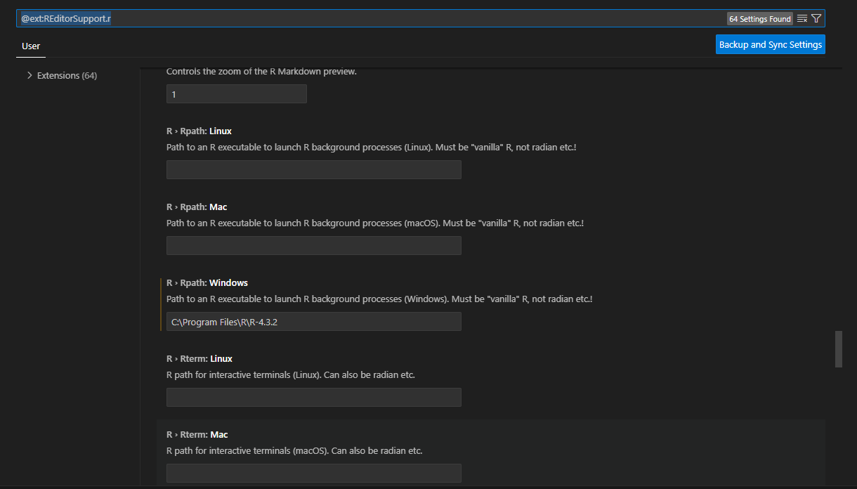
Once off / FHARGA every time you log in
Scroll about ¾ down to R > path

Slide 53

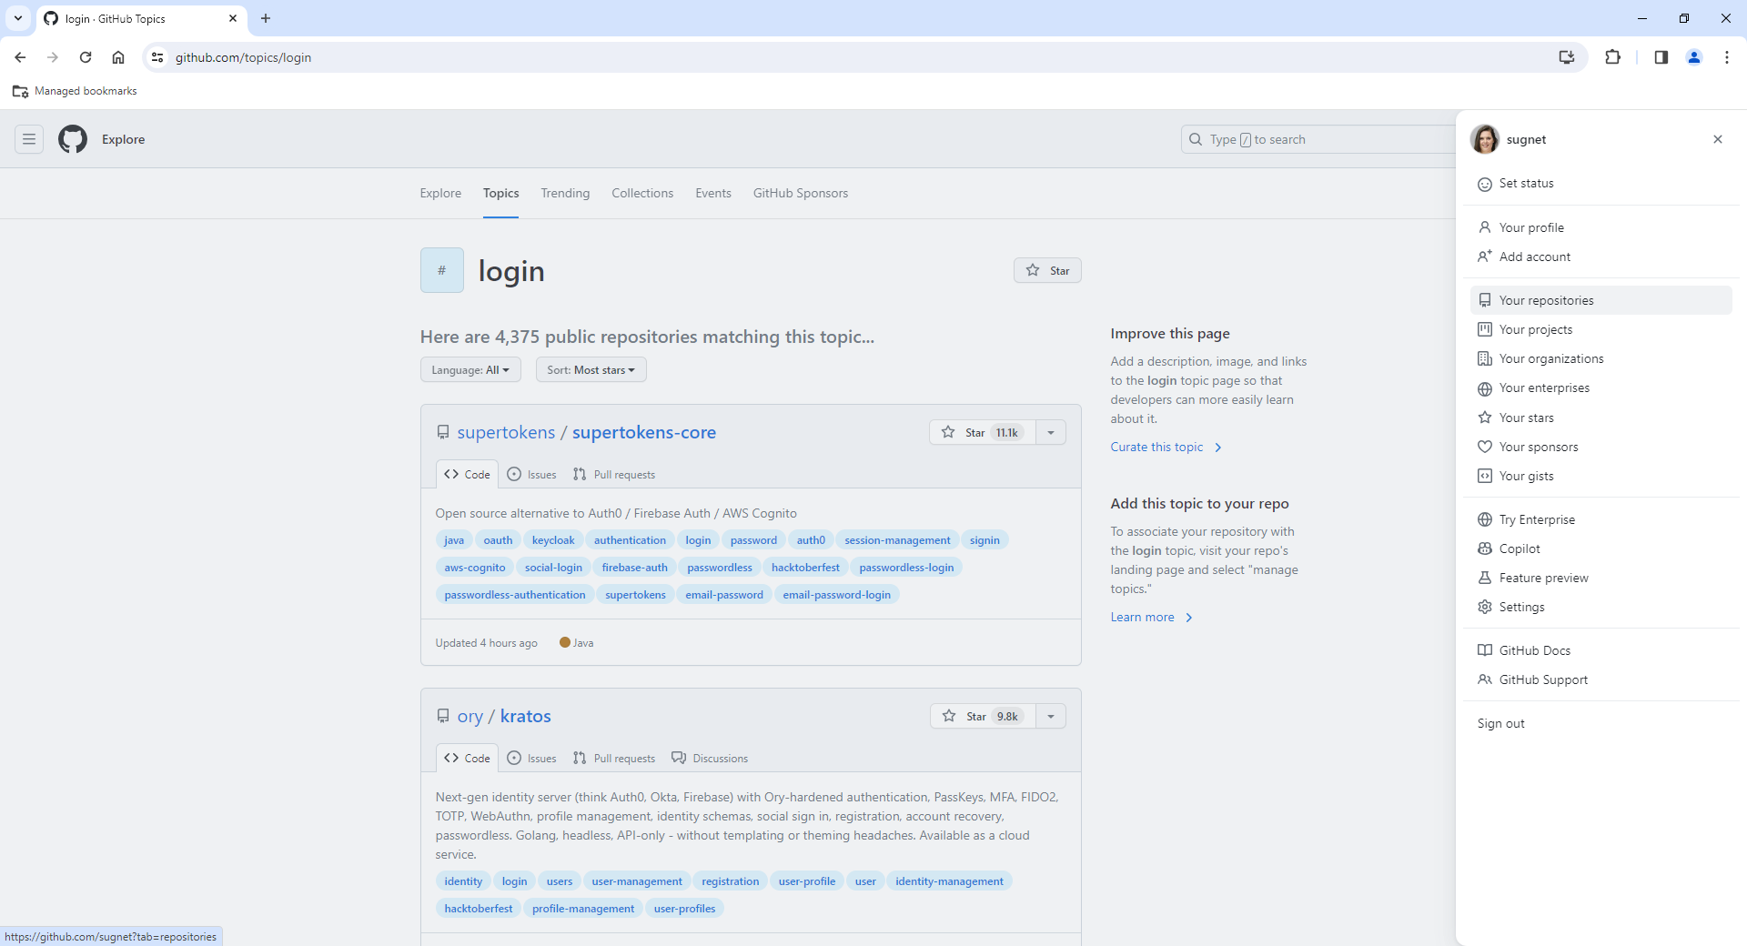

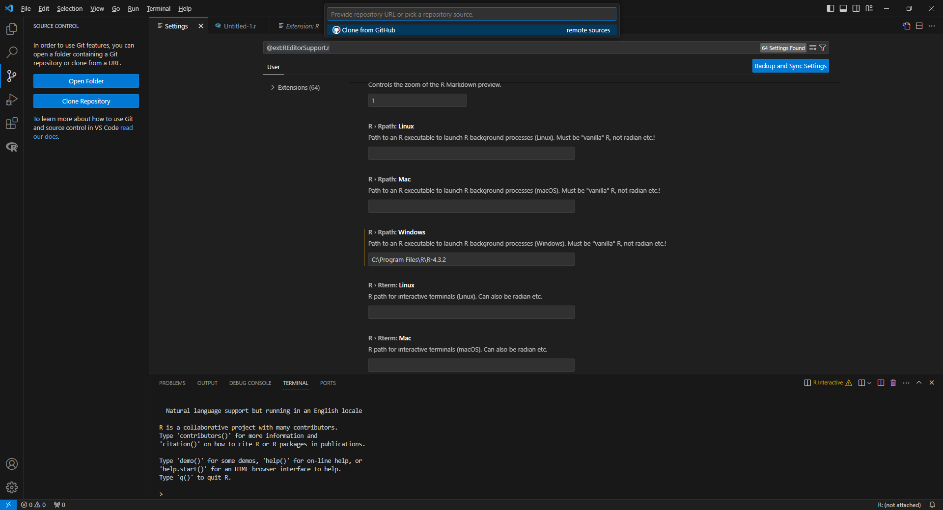
Clone repository
Source control
Clone repository
Repository link
https://github.com/sugnet/Maandag
Paste link
Select local folder for repository

Slide 54
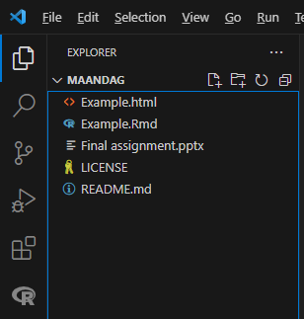
Create your files in the local repository
Visual Studio Code
File > New file > R document
Type code & save
RStudio
Any other software
VSC Explorer

Slide 55
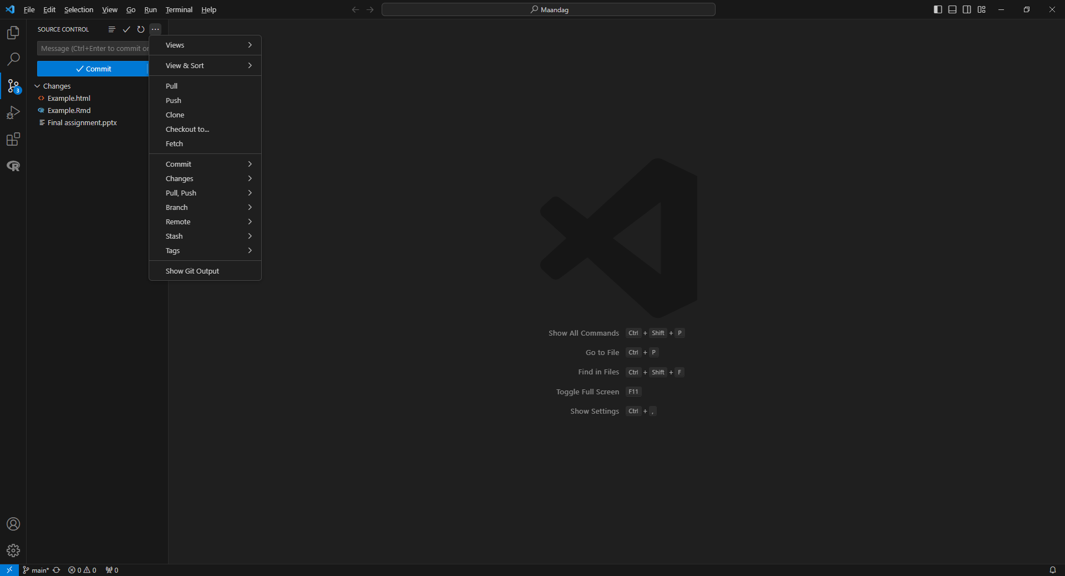
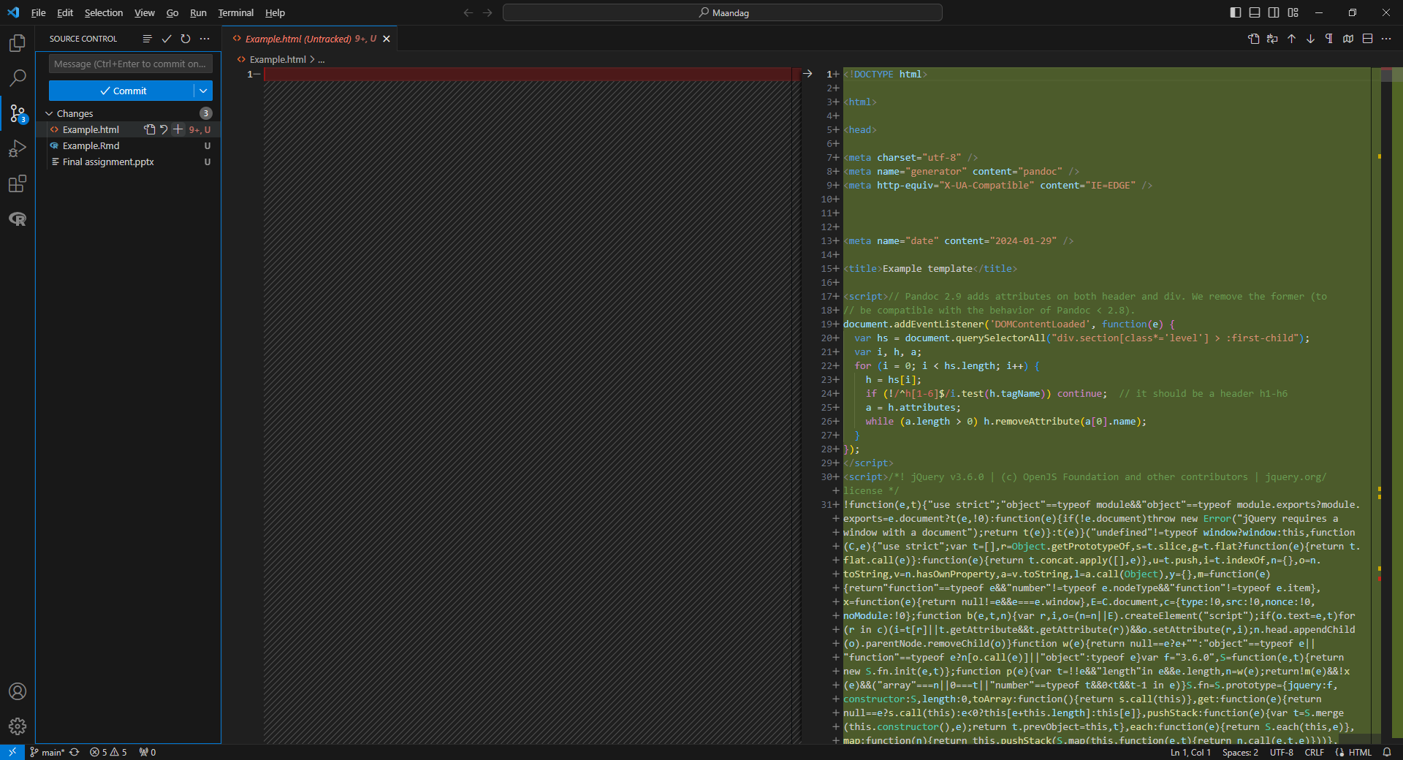
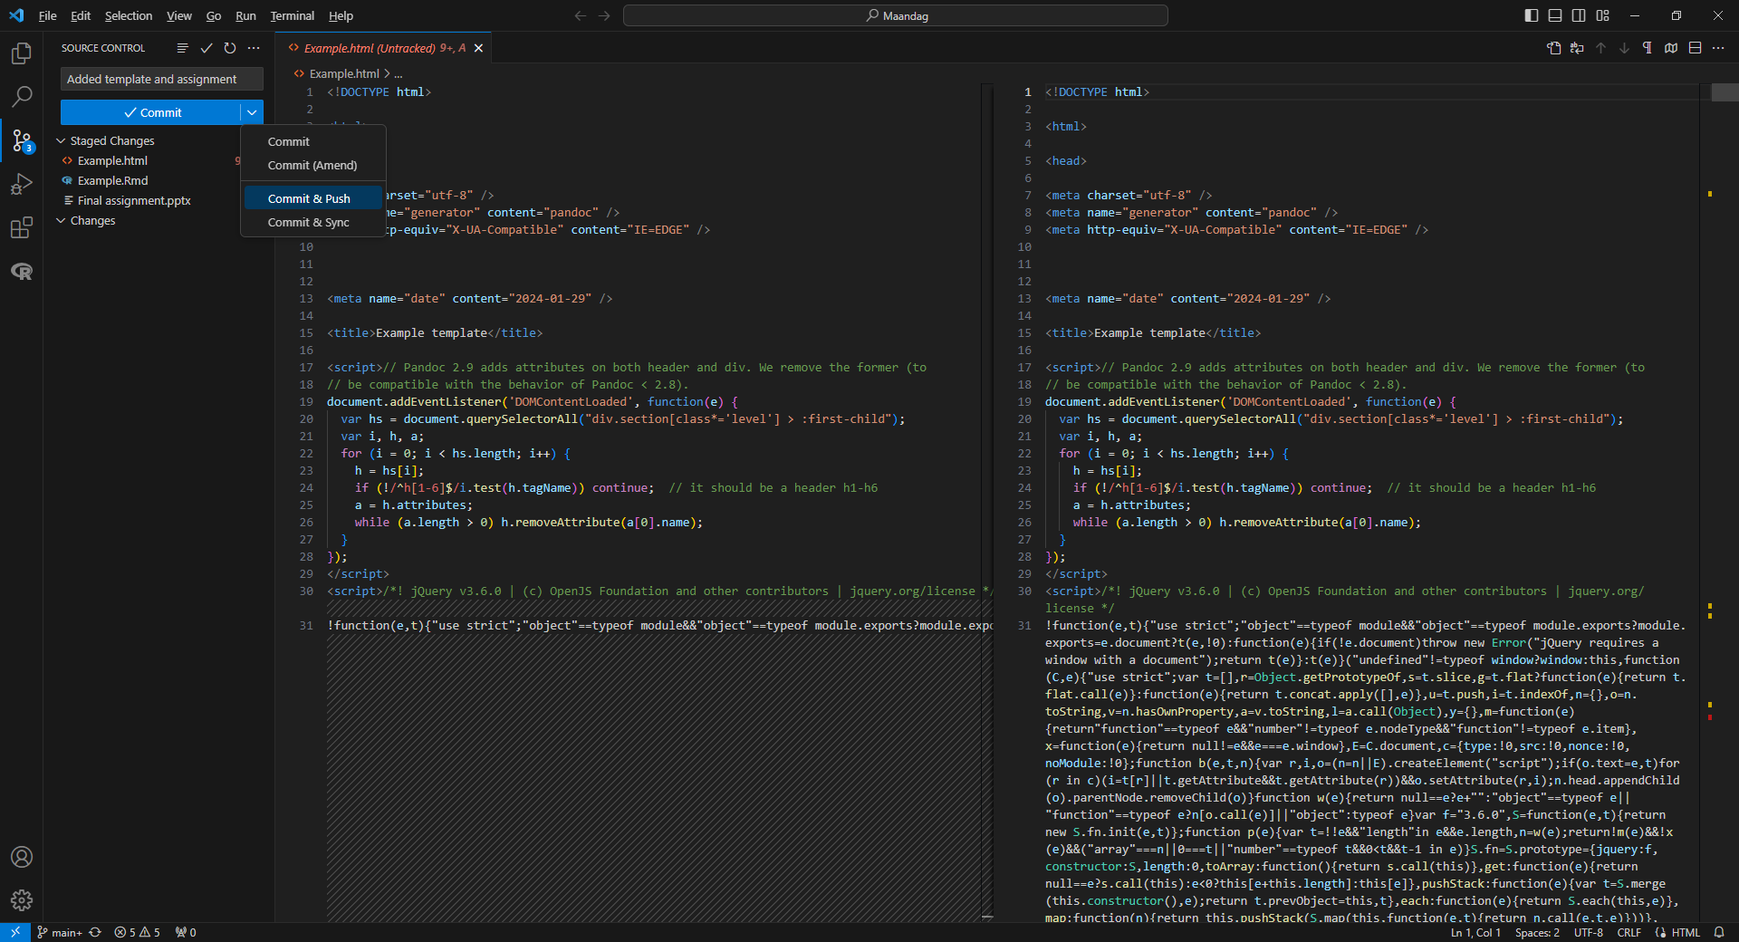
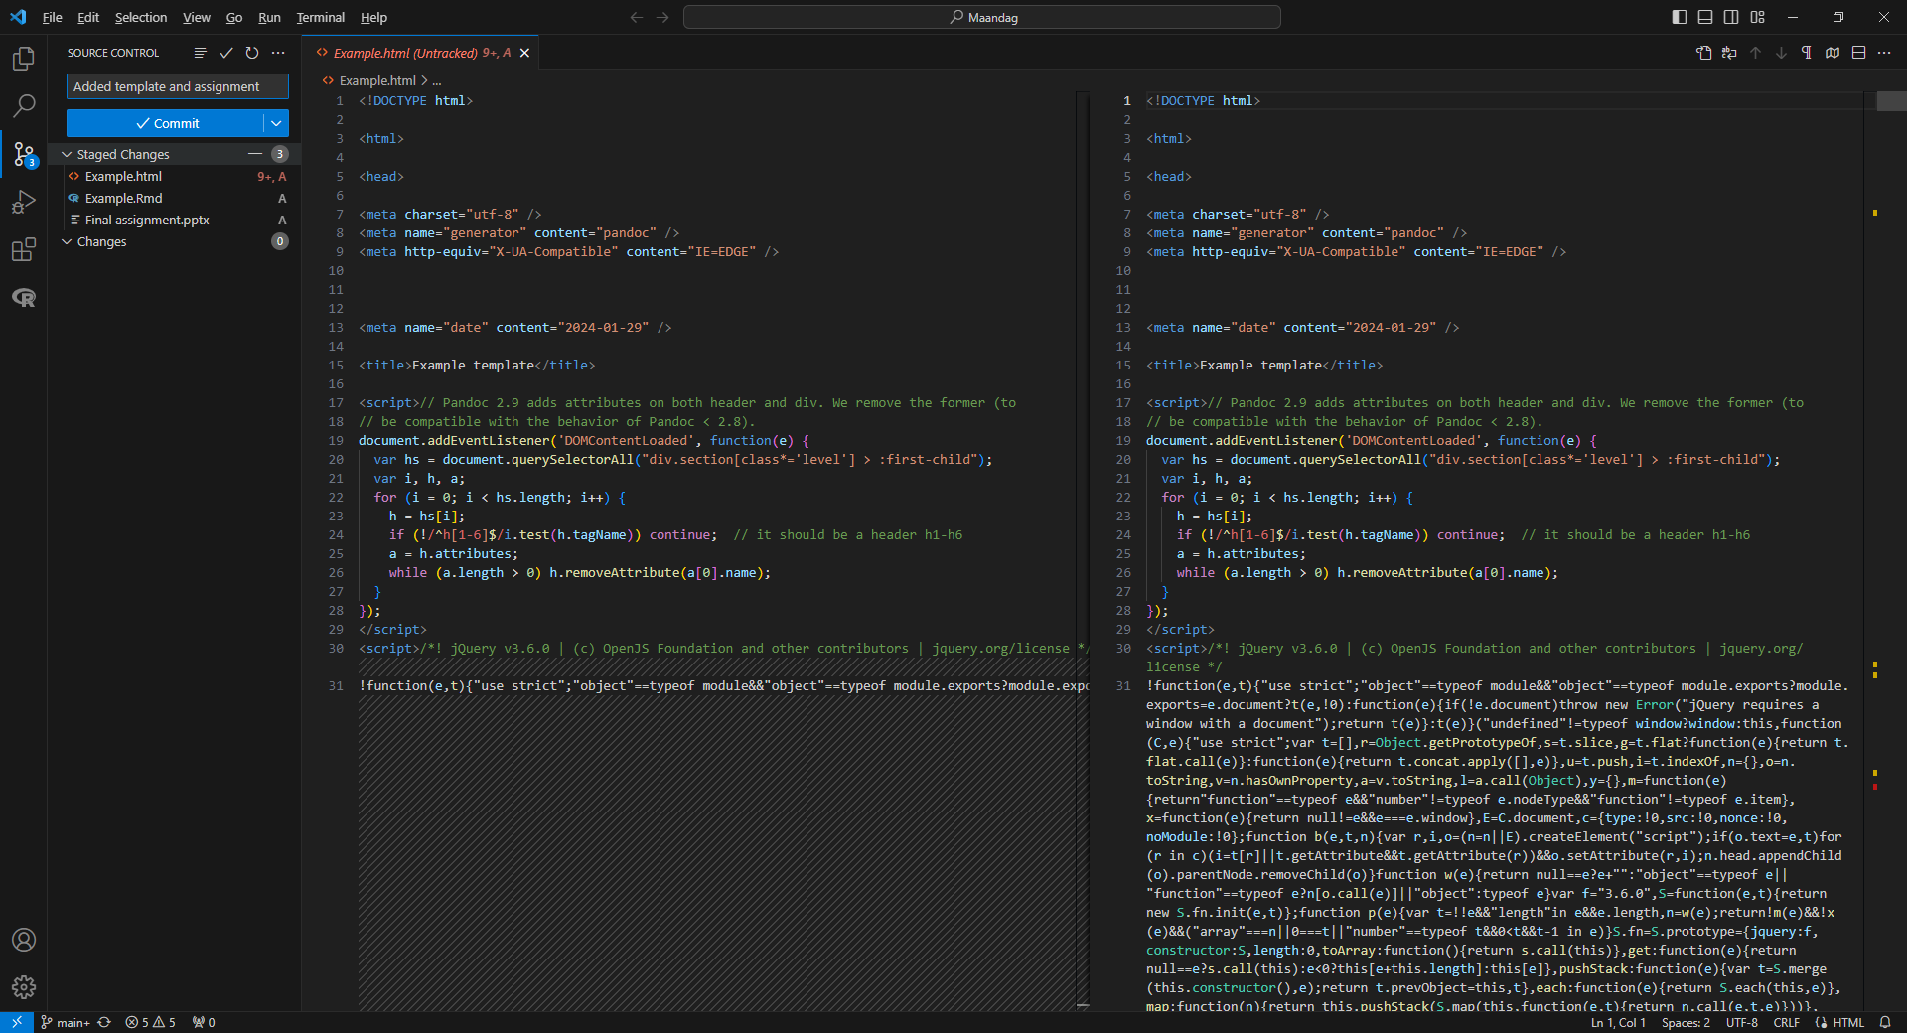
Pull, Commit and Push
Source control
To ensure that you have the latest version, always Pull first
Now your local folder is 100% up to date
Select files to Commit to staging area
Add descriptive comment
Commit and push
Any changes since your last interaction

Slide 56
Returning to your project
Visual Studio Code
Explorer
Open folder with Git repository
Source control
Pull
Push your work frequently to ensure proper version control and backups

Slide 57
.gitignore
Some files you do not want to push to your cloud repository
These files are listed in the file .gitignore
Simple text file
E.g. .Rhistory
.Rdata

Slide 58
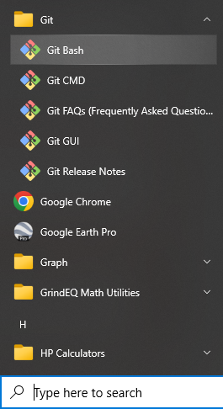
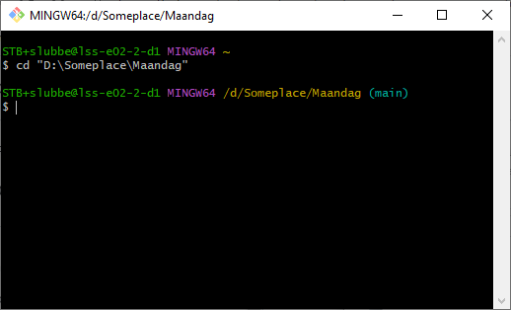
Git without Visual Studio Code
Git Bash
Select folder
cd "D:\Someplace\Maandag"

Slide 59
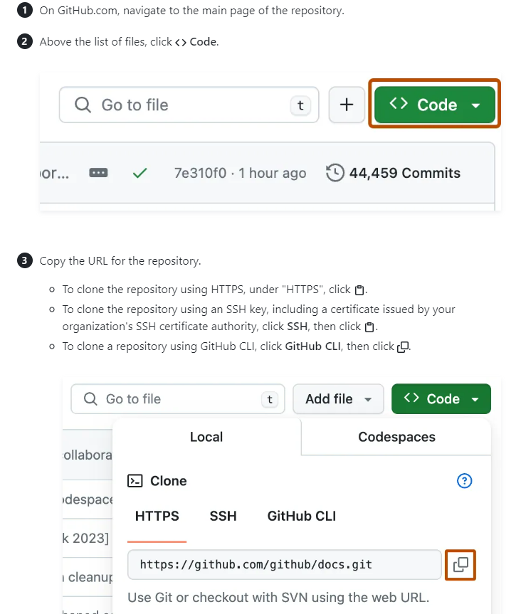
Clone repository

Slide 60
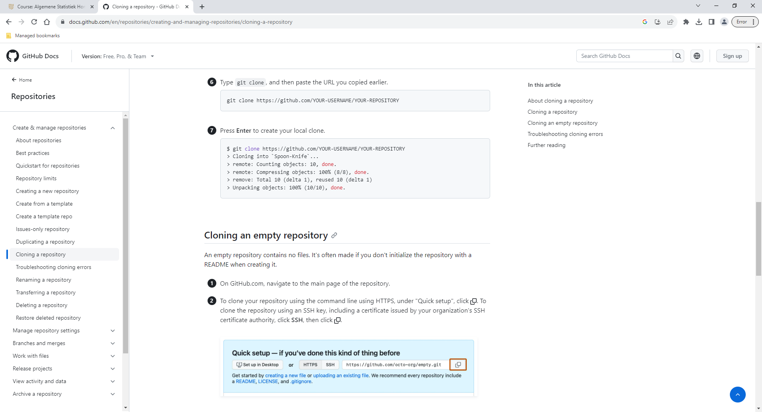
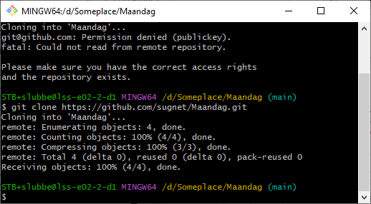
Clone repository
Git Bash
Clone repository
git clone https://github.com/sugnet/Maandag.git

Slide 61
Pull, commit and push
Git Bash
Pull repository
git pull origin main
Add files to the staging area
git add
git add . [ all files in folder ]
Commit files
git commit filename.xyz –m "descriptive message"
git commit . –m "descriptive message" [ all files in folder ]
You still need to push the files to the cloud
git push origin main
Create branch
git branch branch_name

Slide 62
Pull, commit and push
Git Bash
Create branch
git branch branch_name
Switch branch
git checkout NewName
Merge branch
git checkout name_branch [branch to which to merge]
git merge NewName [branch to merge into name_branch]

Slide 63
Git bash commands
ls [list files inside folder]
ls –a [also list hidden files]
cd [change directory/folder]
cd .. [parent folder]
mkdir foldername [make new folder]
mv file_or_folder_to_more folder_to [move files or folders]
cp file_or_folder_to_more folder_to [copy files or folders]
git status [state of the local repository and staging area]
git log [information about the commits in the repository]

Slide 64


Working with Git/GitHub
Work on your project
Make changes to your files
Save changes in your local folder
Commit changes to your local repo: Gitbash
git add filename / git add . (everything in your local folder)
git commit –m “message about this round of updates”
Pull latest online version: Gitbash
git pull origin main
This ensures that everything is in sync if changes happened in the cloud
Push your changes to GitHub: Gitbash
Now that your local version has all your new work + any updates from the cloud combined
git push origin main

Slide 65
Branching
Default: main (master) branch
Person B
Changed output
pull
push
main
main
main
main
pull
push
Add another option
Person A

Slide 66
Branching
Default: main (master) branch
Person B
Changed output
pull
push
main
main
main
main
pull
push
Develop phase II
Person A
Do version control and backups while working on phase II

Slide 67
Branching
Person B
Changed output
pull
push
main
main
main
main
git branch phase2
git merge phase2
Person A
phase2
git checkout phase2
phase2
phase2
phase2
phase2
git checkout main
pull
push
Some work
More work, pull, push, work, …, push

Slide 68
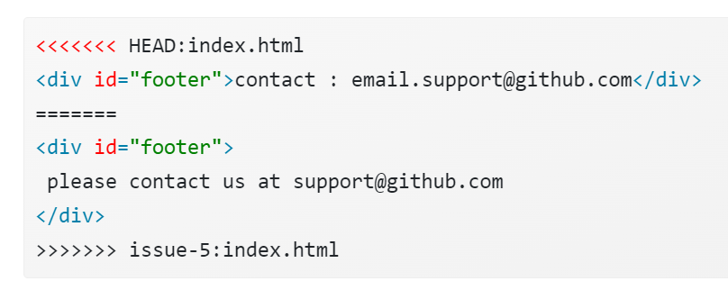
Branching: Conflicts
Read here: https://happygitwithr.com/git-branches
Text file opens
Conflict start
Conflict end

Slide 69
Branching: Conflicts
Read here: https://happygitwithr.com/git-branches
Text file opens
One version
Alternative version

Slide 70
Branching: Conflicts
Delete unwanted version
<div id="footer">
please contact us at support@github.com
</div>

Slide 71
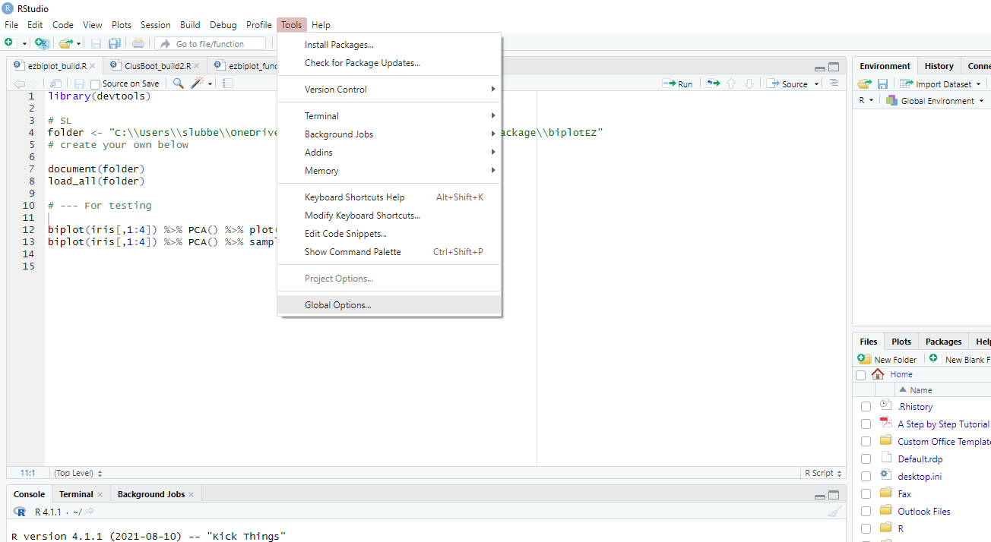
RStudio

Slide 72
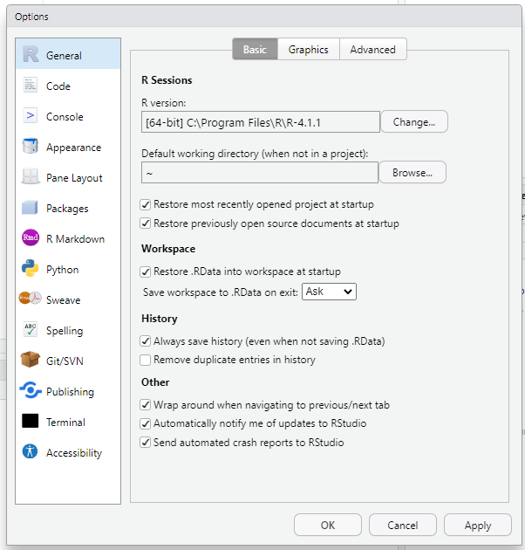
RStudio

Slide 73
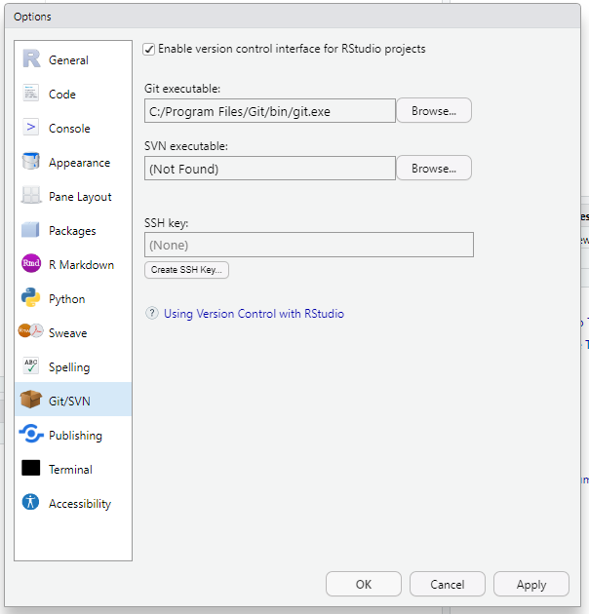
RStudio

Slide 74
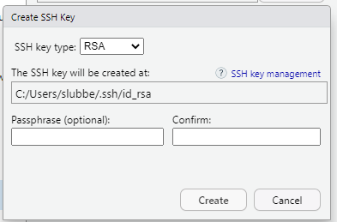
RStudio

Slide 75
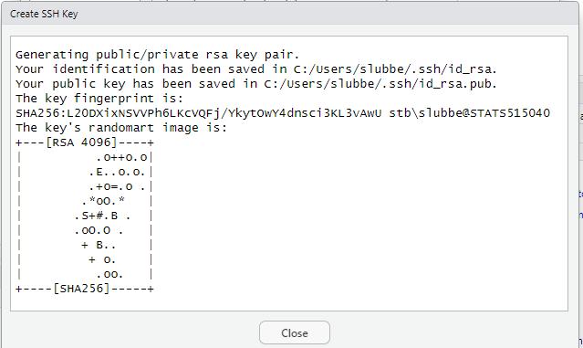
RStudio

Slide 76
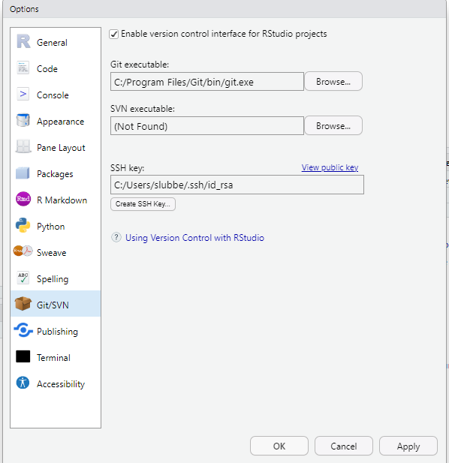
RStudio

Slide 77
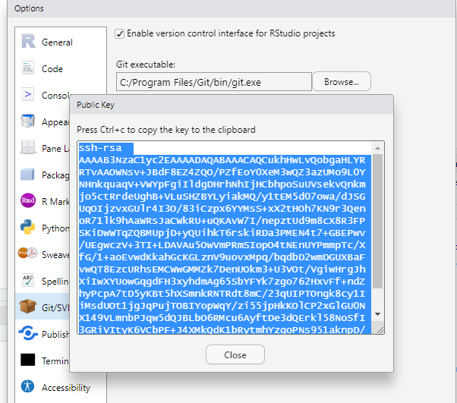
RStudio
Copy to clipboard

Slide 78
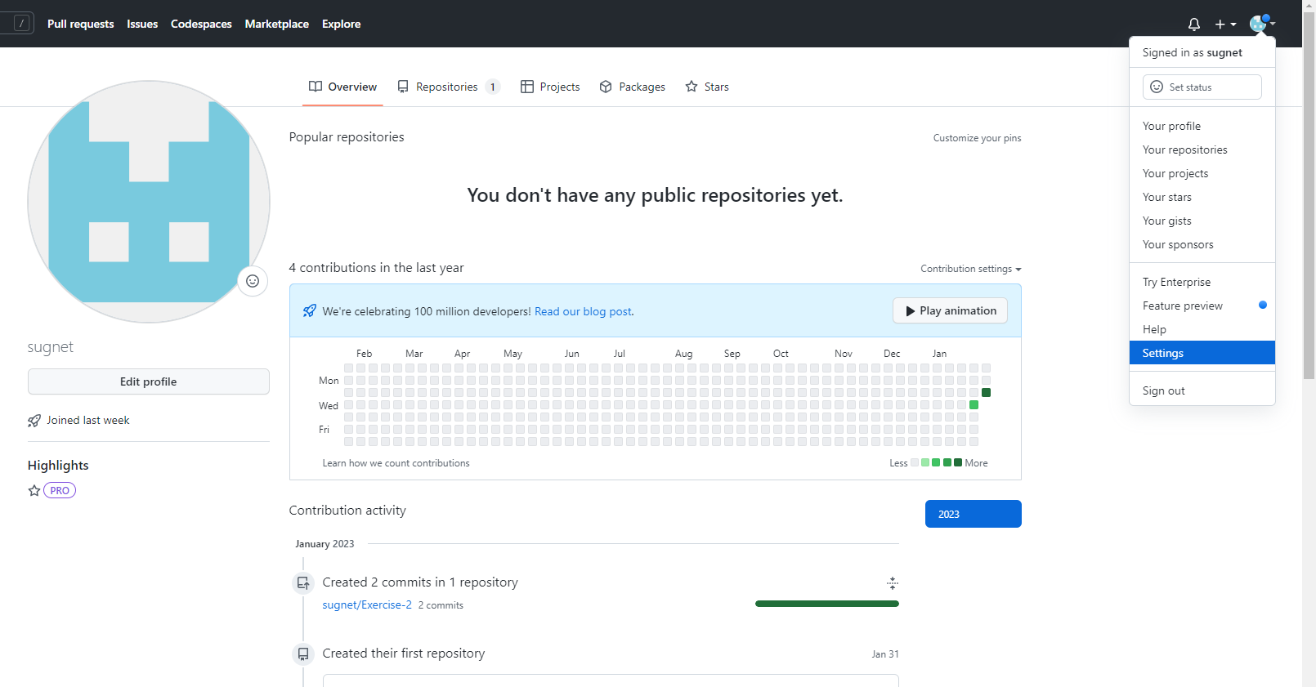
GitHub

Slide 79
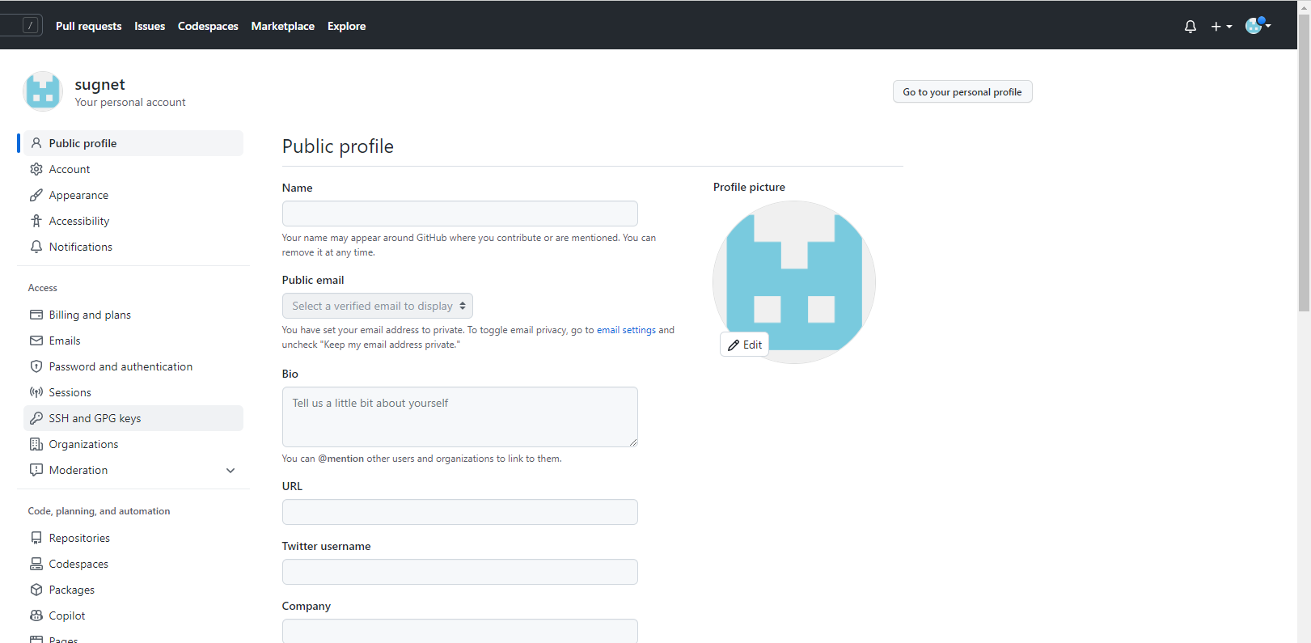
GitHub

Slide 80
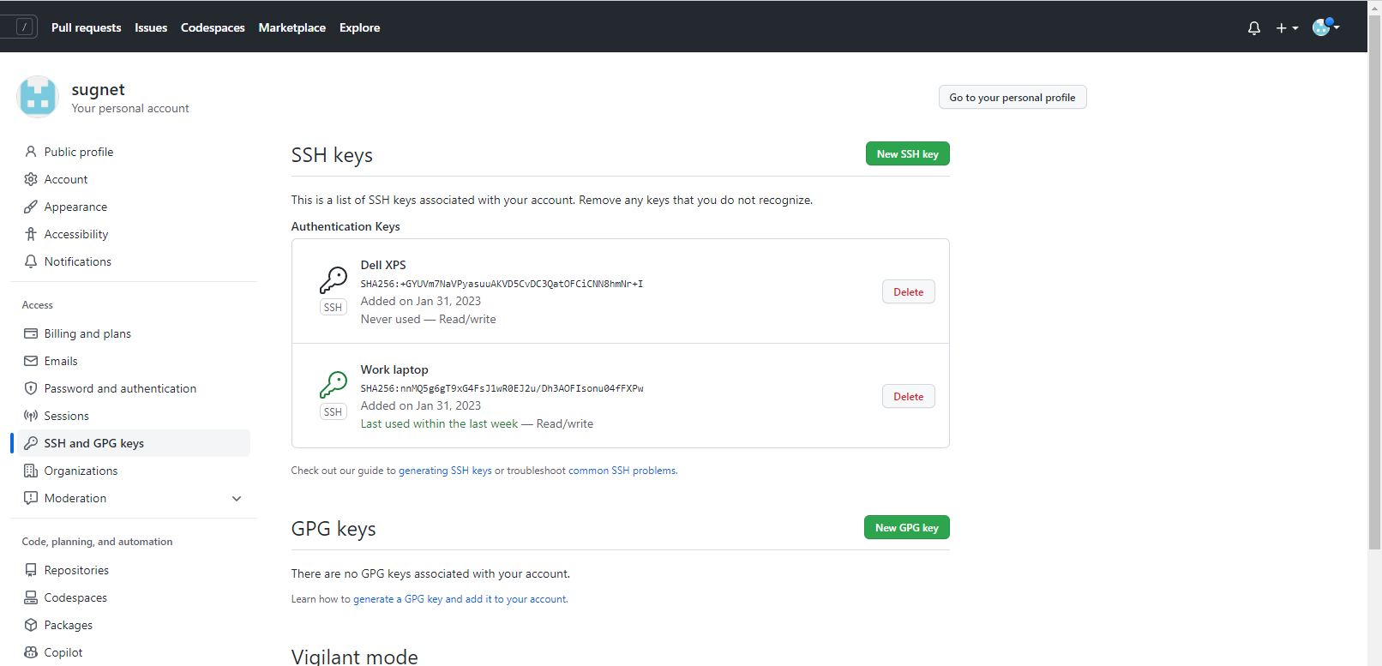
GitHub

Slide 81
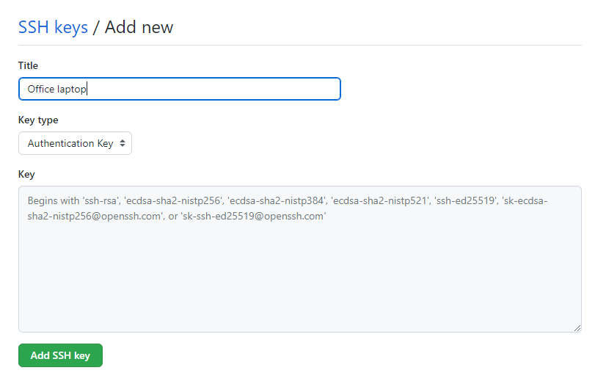
GitHub
Paste

Slide 82
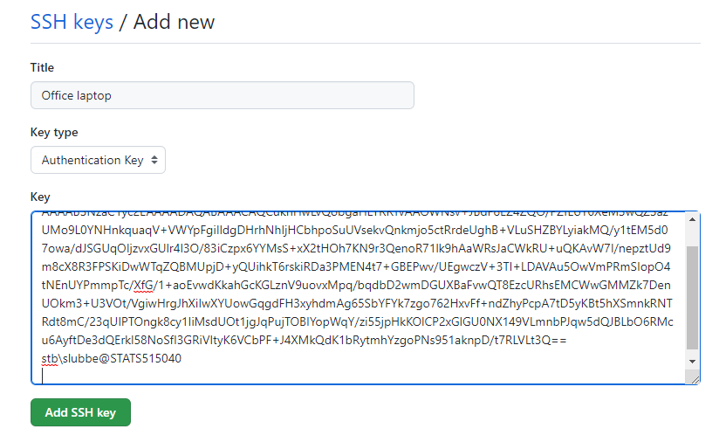
GitHub

Slide 83
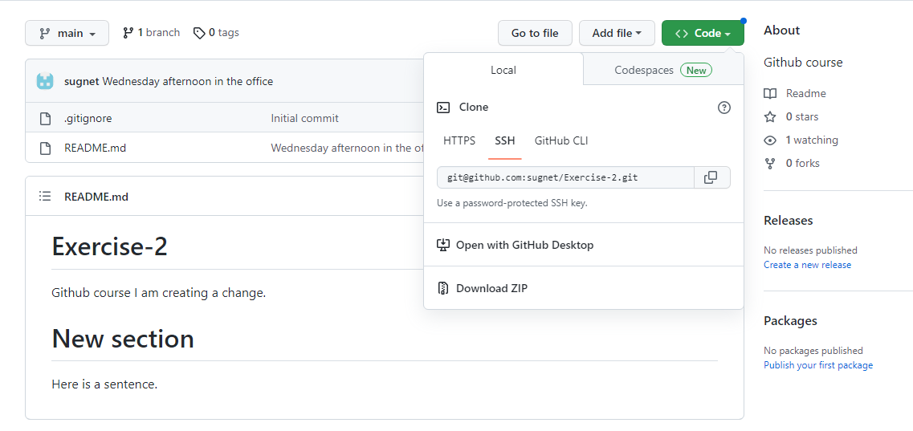
Clone repository

Slide 84

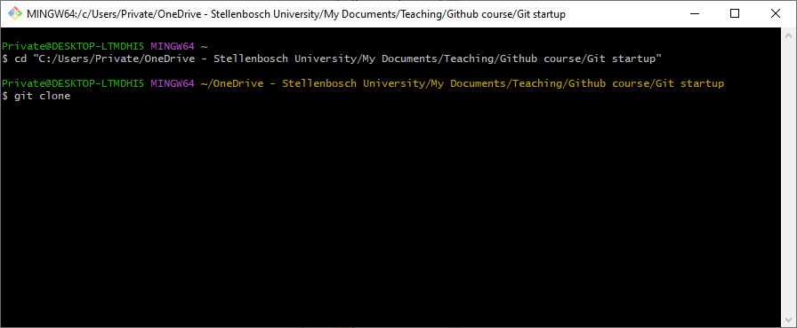
Clone repository
Git Bash

Slide 85
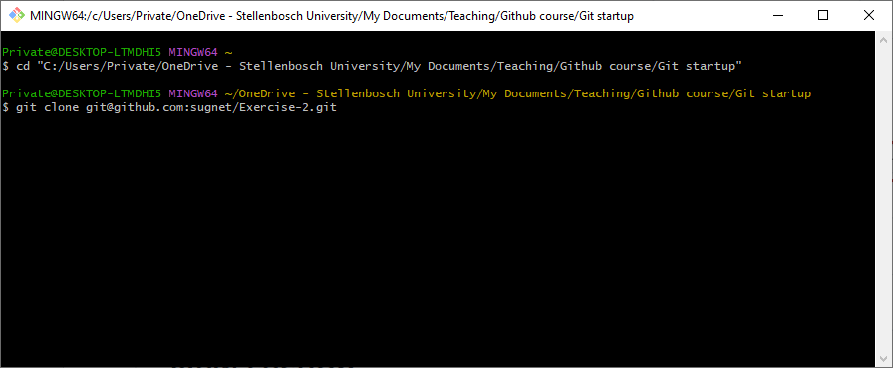
Clone repository

Slide 86

RStudio

Slide 87

RStudio

Slide 88

RStudio

Slide 89

RStudio

Slide 90

Commit without Gitbash
git add filename

Slide 91
Commit without Gitbash
git commit –m “message”

Slide 92

Commit without Gitbash
git commit –m “message”

Slide 93
Commit without Gitbash
git pull origin main

Slide 94
Commit without Gitbash
git push origin main

